Slide 1
Using the Nagel-Schreckenberg model to investigate traffic patterns on the R44 in Stellenbosch
By Zander Vermeulen
14 November 2023
Notes:
Solid maroon background slide
The ghost text placeholder is fully scalable and movable.
To add a background image:
Right-click on the slide and choose Format Background …
Click on the Picture or texture fill option and click on the Insert button.
Browse and select a picture and click on the Insert button.
Remember to add image attributions to photographs or artworks.

Slide 2
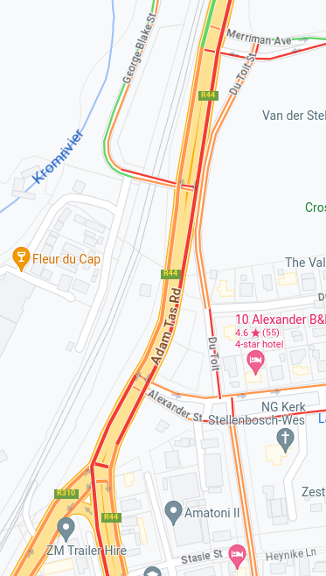
Background & Introduction
Model traffic on the R44 between Merriman Avenue and the R310
One of the most congested road segments in Stellenbosch
Consider strategies used by drivers to avoid traffic
Phase 1: Original model
Phase 2: Junctions
Phase 3: Traffic lights
Phase 4: Du Toit Street bypass
Fig. 1: The road segment under investigation

Slide 3
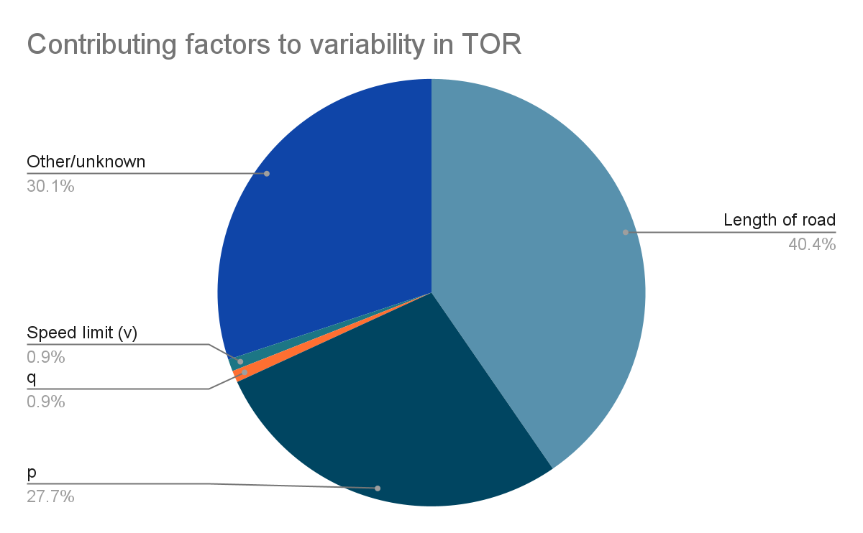
Phase 1: The Original Model
Closest to original model
Vehicles appear at north end of road and disappear at south end
Track average time vehicle spends on road (TOR)
Length of road has biggest effect, followed by probability of randomly slowing down (p)
Fixing road length revealed low- and high-p regimes
Probability of vehicle appearing at the start: q
Fig. 2: Contributing factors to average time spent on road

Slide 4
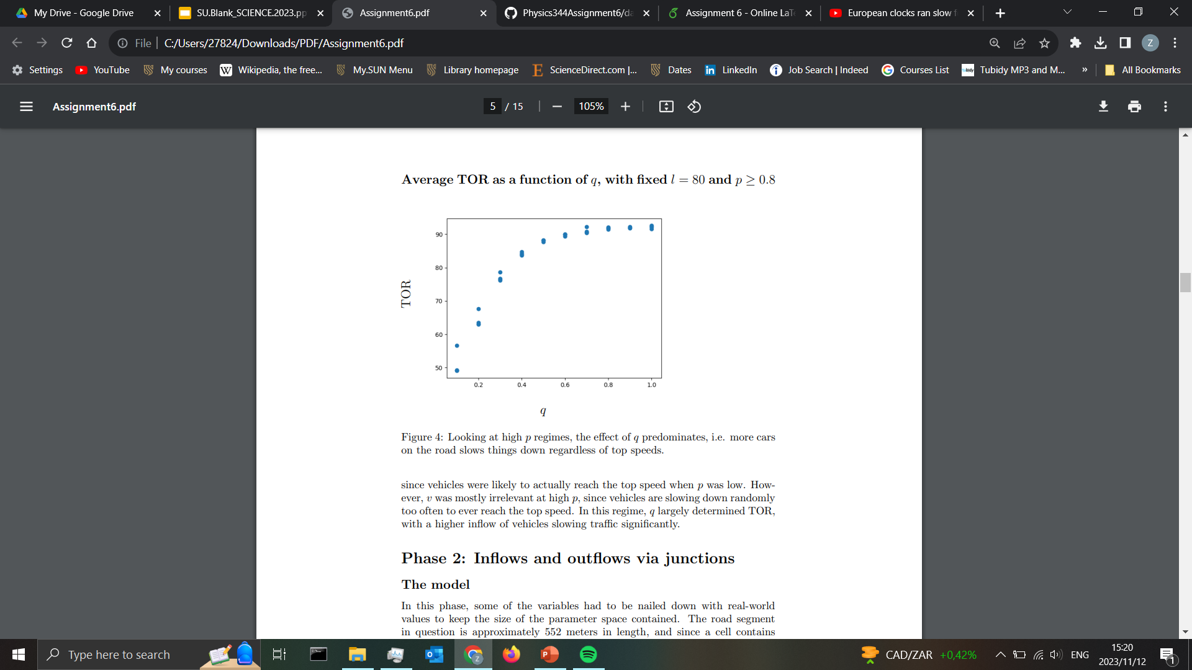
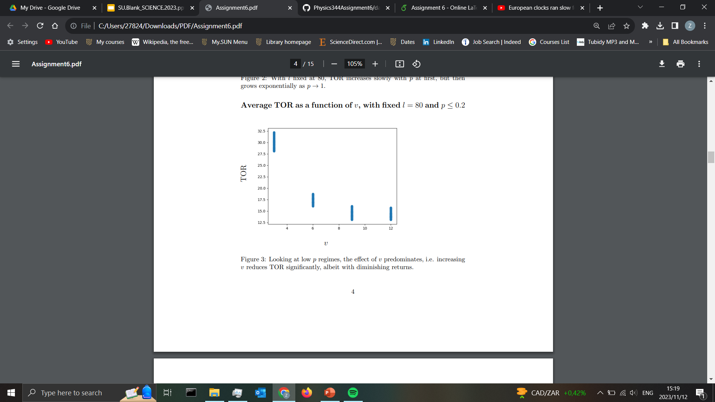
Phase 1 continued
Two regimes when length fixed
At low p: effect of v predominates
Vehicles keep moving regardless of congestion
At high p: effect of q predominates
Vehicles never reach top speed and congestion slows everything down
Fig. 3: TOR as a function of q with fixed l and high p
Fig. 4: TOR as a function of v with fixed l and low p

Slide 5
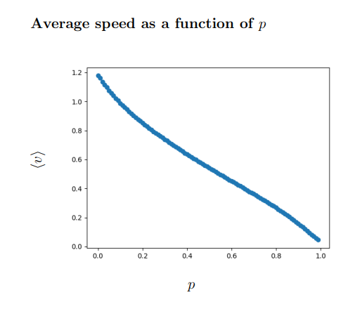
Phase 2: Introducing Junctions
Start fixing some variables
Cell length = 7.5m
Road length: 74 cells
v = 9 (97.2km/h)
Time-step = 2.5s
Record real-world data: vehicles per hour / 1440 (time-steps per hour)
Look at average speeds for different p-values
0.08 < p < 0.62 corresponds to real-world travel times, average p = 0.31
Fig. 5: Average speed as a function of p

Slide 6
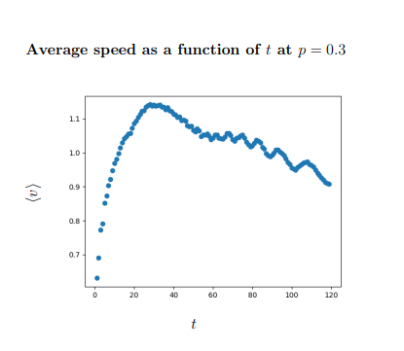
Phase 3: Traffic lights at junctions
Vehicles can only enter/exit at junction when light is green
Light stays green/red for t time-steps
Investigate average speed for different p and t
Record length of queue waiting to enter from each junction
Sped up traffic significantly, although some vehicles spend long times waiting in queue
At p = 0.3, maximum speeds are reached when t = 27 (67.5s between light changes)
Lights actually change every 30-40s
Fig. 5: Average speed as a function of t, p = 0.3

Slide 7
Phase 4: Du Toit Street bypass
Fixed p = 0.3 and t = 14 (35s)
Drivers on Merriman can head down Du Toit Street and join R44 at Alexander Street instead
Considered effect of d, probability of taking detour down Du Toit Street
Heading down Du Toit Street was almost never advantageous for individual
However, relieved congestion on R44, allowing traffic to move faster there
Fig. 1: The road segment under investigation
Fig. 6:

Slide 8
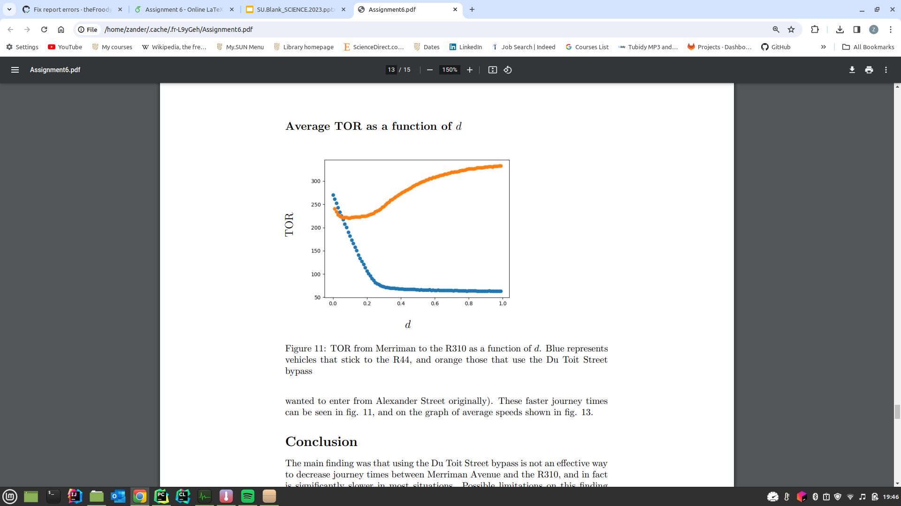
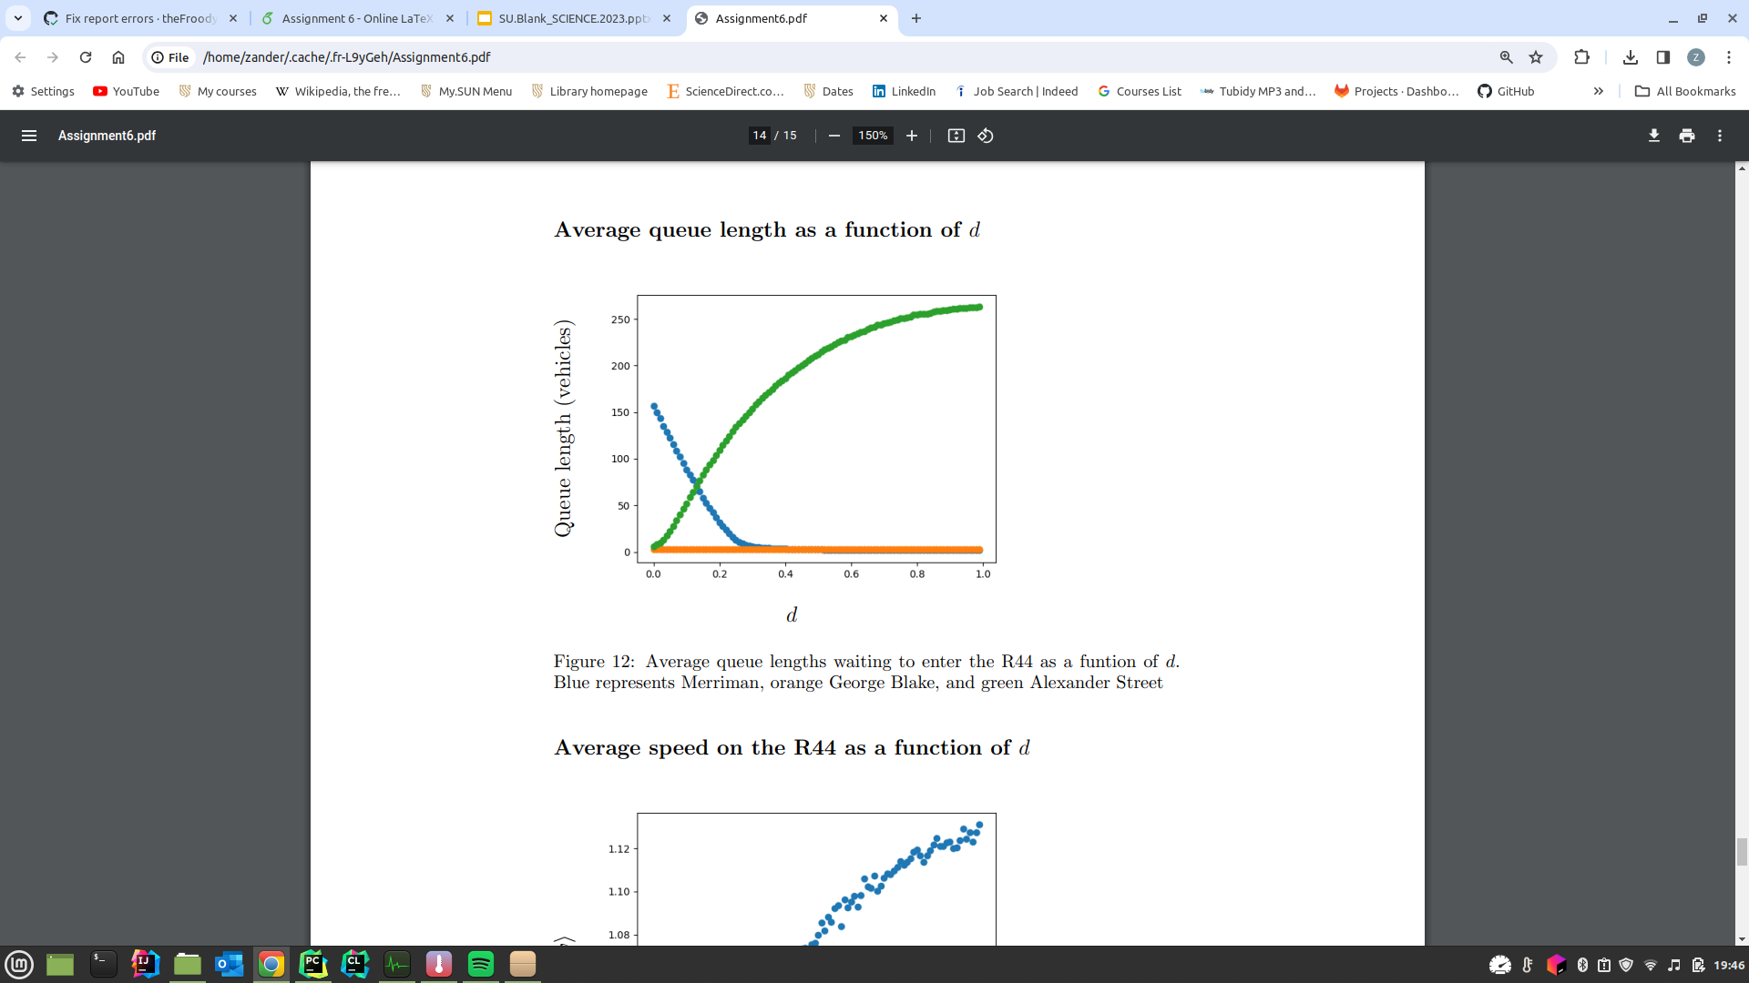
Phase 4: Some more data
Fig. 6: TOR as a function of d for each route. Blue represents R44, orange Du Toit Street
Fig. 7: Average queue lengths as a function of d. Blue represents Merriman, orange George Blake and green Alexander Street

Slide 9
Limitations & Conclusion
Variability in traffic light timing—depends on traffic conditions
Change in traffic conditions themselves—p, entry and exit probabilities via junctions
Trucks and other large vehicles have lower acceleration and occupy multiple “cells”
Assumptions concerning cell size, value of p, acceleration may simply be unrealistic
Values change as vehicles make their way through the system, potentially affecting decision-making
Traffic lights switch more often than model suggests is optimal—suggests people value taking active role, often more than minimising overall travel time

